Slide 1
APEON - Media screener

Slide 2
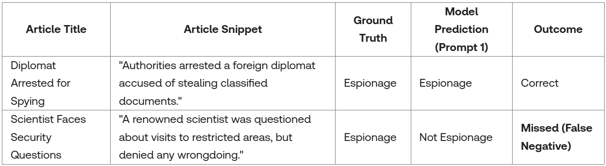
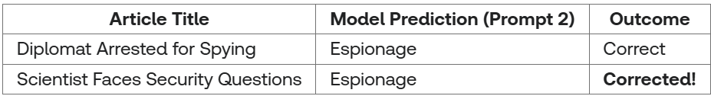
Example Working
Prompt 1: "Classify the following news article as 'Espionage' if it clearly describes an act of espionage or spying information. Otherwise, classify as 'Not Espionage'."
Improved Prompt:
"Classify the following news article as 'Espionage' if it describes either a clear act of spying of classified information, or if the article details investigations, questioning, or suspicion regarding possible espionage activities, even if not proven or explicitly stated. Otherwise, classify as 'Not Espionage'."

Slide 3
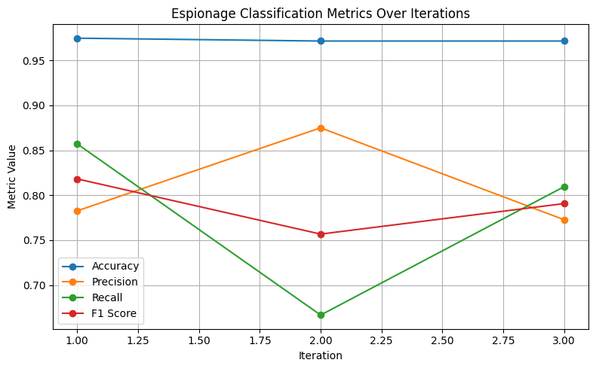
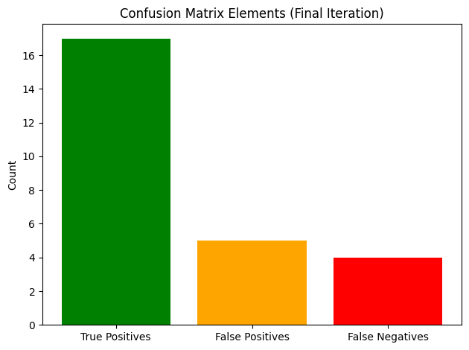
Results

